Slide 1

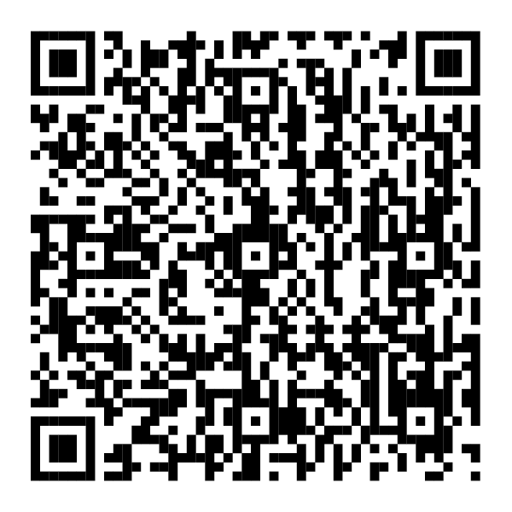

Help build more for your family—siempre más.
This Hispanic Heritage Month, visit the Hispanic community page to see how Fidelity can help you balance work and your personal money needs, while making progress toward your family’s financial goals.
Scan the QR code
Fidelity.com/Hispanic
Investing involves risk, including risk of loss.
The Fidelity Investments logo is a registered service mark of FMR LLC.
Fidelity Brokerage Services LLC, Member NYSE, SIPC, 900 Salem Street, Smithfield, RI 02917
© 2026 FMR LLC. All rights reserved. 1260196.1.0

